Slide 1

GenAI for Developers Unlock the Power of Generative AI with crewAI 11-July-2024

Slide 2

Learning Objectives
Learn about Agentic Architectures
01
Explore CrewAI – an open-source tool for building agents
02
Build a simple and complex AI crew for Portfolio Investment
03

Slide 3

Coding Time! https://github.com/gvossos/genai4devs

Slide 4
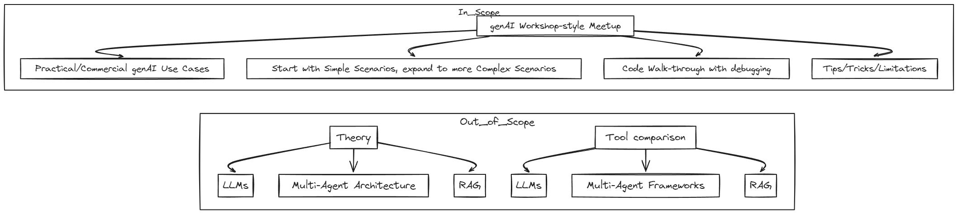
Meetup Event Scope

Slide 5
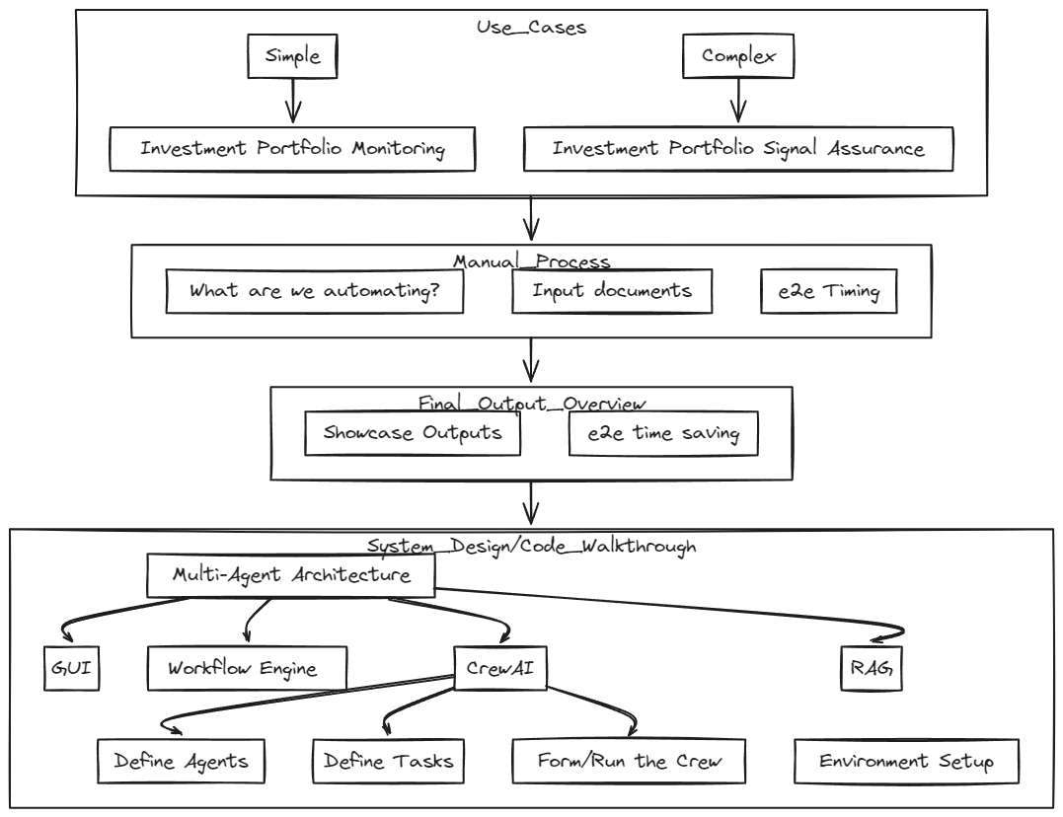

3-Step Use Case Process

Slide 6
Agentic Architecture
Large Language Models (LLMs) excel in tasks such as translation, summarization, and ‘reasoning’ via “zero-shot” & “tree of thought” prompting techniques.
By making LLMs agentic, we can unlock their full reasoning capabilities by enable AI agents to collaborate, iterating through problems and solving them by considering various perspectives, goals, and objectives simultaneously.
AI agents, which are LLMs enhanced with the appropriate tools and prompts, can automate a wide range of tasks including browsing, web scraping, SQL query execution, file operations, and more.
These agents leverage the reasoning abilities of LLMs to select the most suitable tool for any given requirement.
Instead of relying on a single agent for a task, we can use an ensemble of agents to tackle complex tasks more effectively.

Slide 7
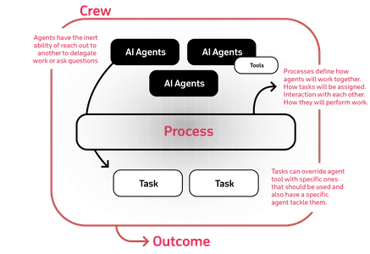
CrewAI: Orchestrating Role-Playing and Autonomous AI Agents
Overview
Open-source framework for collaborative AI agents
Facilitates the creation of agents to achieve complex goals
https://docs.crewai.com/
Key Features
Role-based Agents:
Define agents with specific roles, goals, and backstories
Provides more context to LLMs for answer generation
Task Management
Define tasks with tools
Dynamically assign tasks to agents
Inter-Agent Delegation
Agents delegate tasks to other agents for effective collaboration
Integration
Seamlessly integrates with the Langchain ecosystem

Slide 8
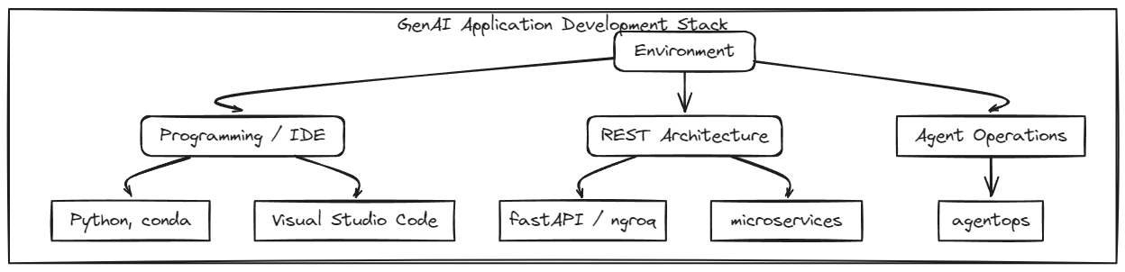
System Design

Slide 9
System Design
v3.10.10
V0.103.0
V0.2.6

Slide 10
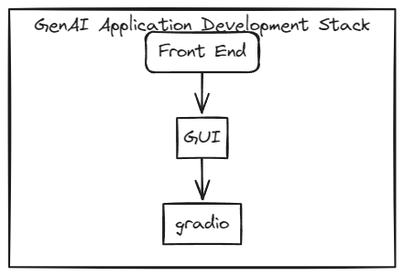
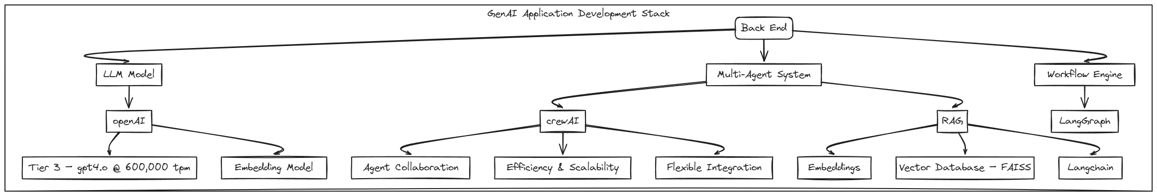
System Design

Slide 11
System Design
v4.37.2
gpt4.o
v0.0.55
v0.36.0
v0.2.6

Slide 12

Complex Use Case: Investment Portfolio Signal Assurance

Slide 13

CrewAI Ensemble
Agents | 11
Tasks | 16
RAG Tools | 15
MonitoringCrew
1x Agent
2x Tasks
2x RAG Tools
MarketCrew
1x Agent
1x Tasks
1x RAG Tool
InvestmentCrew
6x Agent
11x Tasks
9x RAG Tools
ComparisonCrew
3x Agent, incl. txt2speech
3x Tasks
3x RAG Tools

Slide 14
CrewAI Ensemble
STEP 1
detailed summary of investment performance over 30 days,60 days and since inception
Provide a rationale justifying the poor performance of investments based on insights from the current asset allocation view document
Agents | 11
Tasks | 16
RAG Tools | 15
STEP 3
For each Portfolio SWITCH recommendation (BUY/SELL pair)
For each investment
Investment – general info
Investment strategy
Mstar rating
Underlying investments – Top 5 Sector & Country exposures
Impact of Market Conditions on sector & country exposures
Redemption Policy
Investment Performance 7, 30, 90 days etc
Sentiment Analysis
Detailed Trading Recommendation
Future value Predictive forecasting
Detailed recommendation to BUY
MonitoringCrew
1x Agent
2x Tasks
2x RAG Tools
MarketCrew
1x Agent
1x Tasks
1x RAG Tool
InvestmentCrew
6x Agent
11x Tasks
9x RAG Tools
ComparisonCrew
3x Agent, incl. txt2speech
3x Tasks
3x RAG Tools
STEP2
considering the impact of major macroeconomic data
STEP 4
Compare Portfolio SWITCHES
Translate the contents of the text file to voice file .mp3
Send email with the .mp3 attachment generated from the text_2_speech agent

Slide 15
Simple Use Case: Investment Portfolio Monitoring

Slide 16
Crew Ensemble
STEP 1
detailed summary of investment performance over 30 days,60 days and since inception
Provide a rationale justifying the poor performance of investments based on insights from the current asset allocation view document
Agents | 11
Tasks | 16
RAG Tools | 15
MonitoringCrew
1x Agent
2x Tasks
2x RAG Tools
MarketCrew
1x Agent
1x Tasks
1x RAG Tool
InvestmentCrew
6x Agent
11x Tasks
9x RAG Tools
ComparisonCrew
3x Agent, incl. txt2speech
3x Tasks
3x RAG Tools

Slide 17
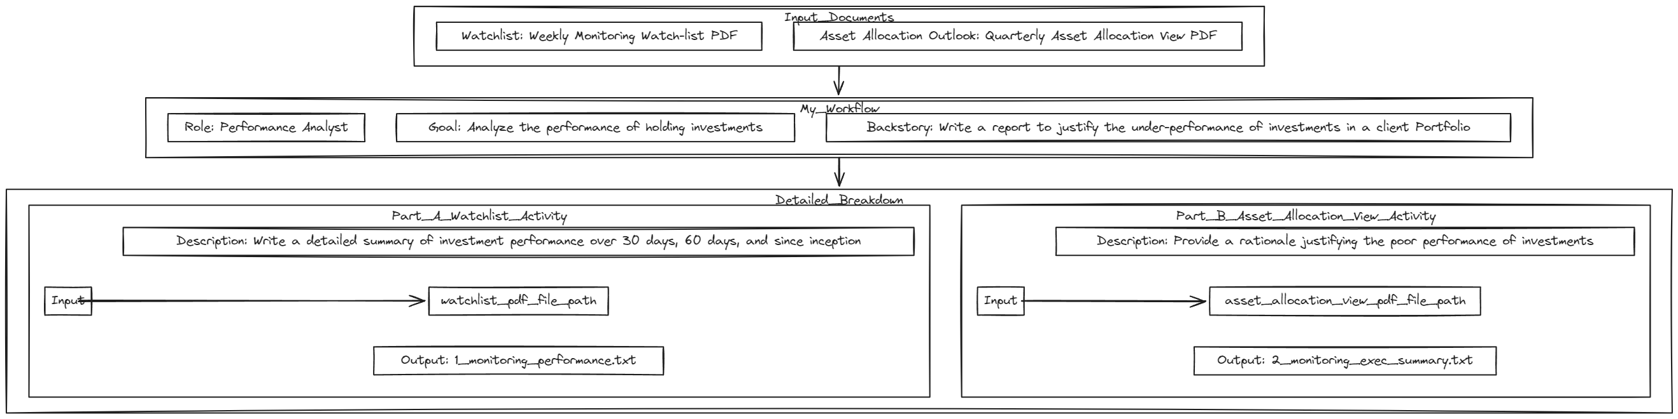
1a. Manual Process

Slide 18
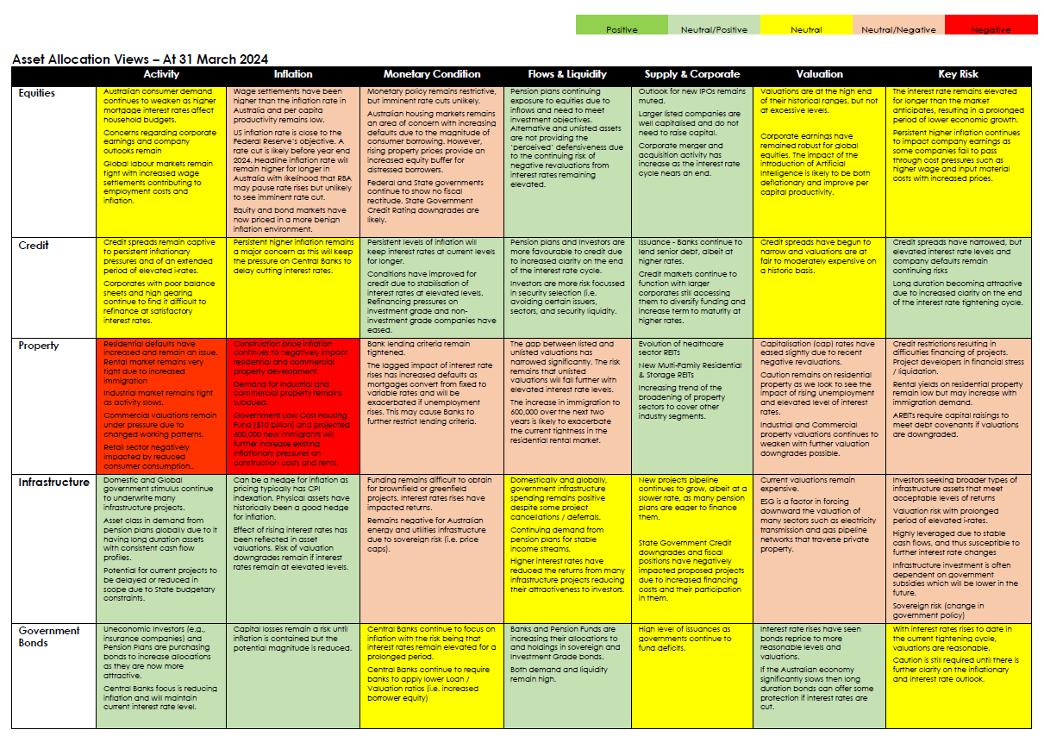
1b. Input Documents – Asset Allocation View (PDF)

Slide 19
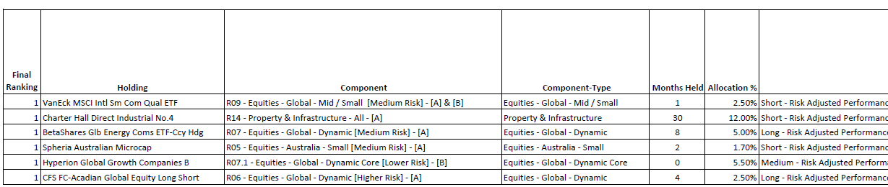
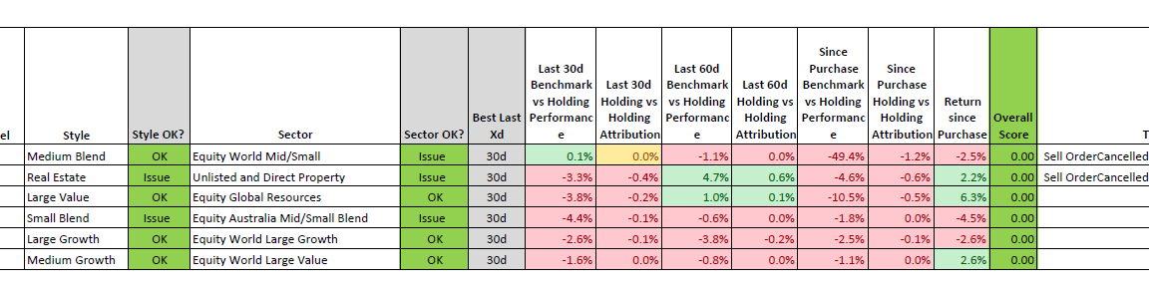
1b. Input Documents – Investment Risks (PDF)

Slide 20
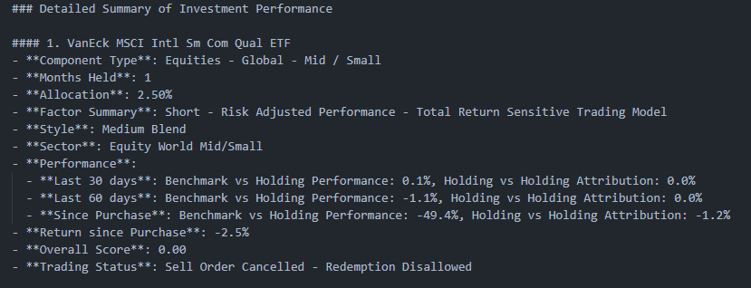
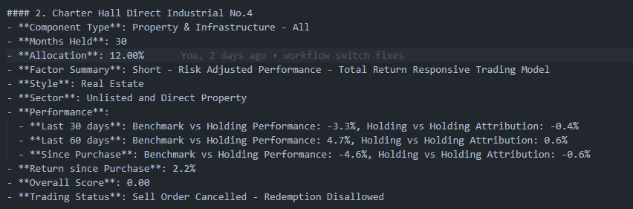
2a. Final Output Overview -- Monitoring Performance --

Slide 21
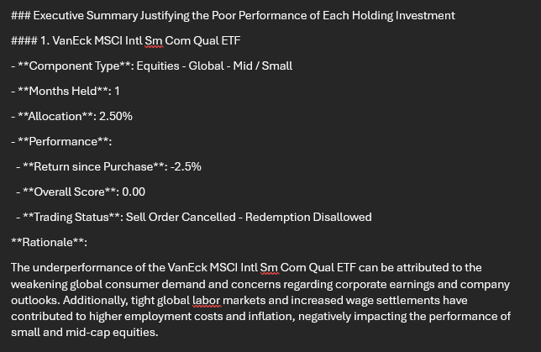
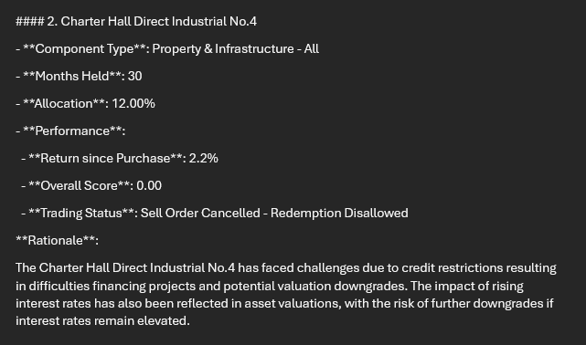
2b. Final Output Overview -- Monitoring Executive Summary --

Slide 22
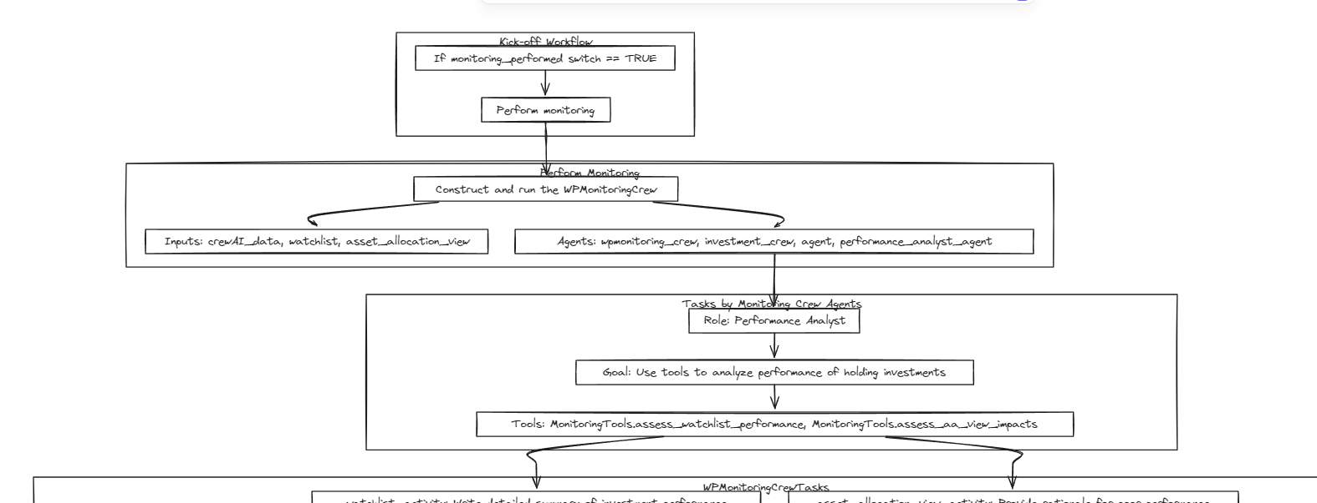
3a. Automated Process

Slide 23
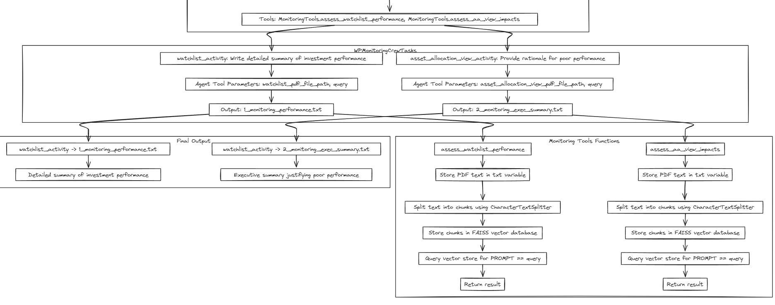
3b. Automated Process

Slide 24
4c. Simple Use Case - CrewAI Formation
MonitoringCrew
1x Agent
2x Tasks
2x RAG Tools

Slide 25
5. Coding Time! https://github.com/gvossos/genai4devs

Slide 26
Complex Use Case: Investment Portfolio Signal Assurance

Slide 27
CrewAI Ensemble
STEP 1
detailed summary of investment performance over 30 days,60 days and since inception
Provide a rationale justifying the poor performance of investments based on insights from the current asset allocation view document
Agents | 11
Tasks | 16
RAG Tools | 15
STEP 3
For each Portfolio SWITCH recommendation (BUY/SELL pair)
For each investment
Investment – general info
Investment strategy
Mstar rating
Underlying investments – Top 5 Sector & Country exposures
Impact of Market Conditions on sector & country exposures
Redemption Policy
Investment Performance 7, 30, 90 days etc
Sentiment Analysis
Detailed Trading Recommendation
Future value Predictive forecasting
Detailed recommendation to BUY
MonitoringCrew
1x Agent
2x Tasks
2x RAG Tools
MarketCrew
1x Agent
1x Tasks
1x RAG Tool
InvestmentCrew
6x Agent
11x Tasks
9x RAG Tools
ComparisonCrew
3x Agent, incl. txt2speech
3x Tasks
3x RAG Tools
STEP2
considering the impact of major macroeconomic data
STEP 4
Compare Portfolio SWITCHES
Translate the contents of the text file to voice file .mp3
Send email with the .mp3 attachment generated from the text_2_speech agent

Slide 28
Coding Time! https://github.com/gvossos/genai4devs

